Slide 1
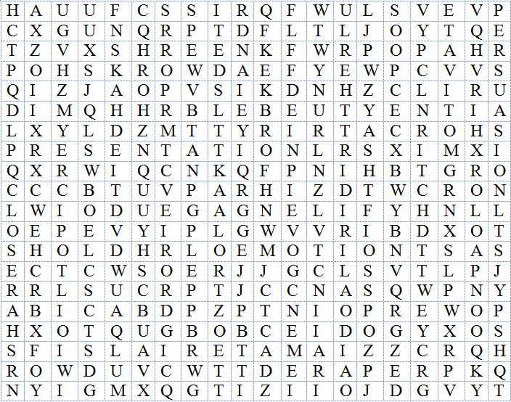
Presentation Workshop Word Search
Note: Words are in all directions
CLOSER WORKSHOP
CREDIBILITY ENGAGE
PRESENTATION SPEAKER
EDUCATE MATERIALS
EMOTION MOTIVATE
LOGIC PERSUASION
OPENER LOCATION
FOCUS PREPARE
POWERPOINT TOPIC
BOB LORTZ

Slide 2
Presentation Workshop Word Search
Note: Words are in all directions
CLOSER WORKSHOP
CREDIBILITY ENGAGE
PRESENTATION SPEAKER
EDUCATE MATERIALS
EMOTION MOTIVATE
LOGIC PERSUASION
OPENER LOCATION
FOCUS PREPARE
POWERPOINT TOPIC
BOB LORTZ

